Slide 1
OLINK Update

Slide 2
Notes:
This does not include any of our data, this is only intended to provide some information about the distribution of targets in the OLINK 3072 panel

Slide 3
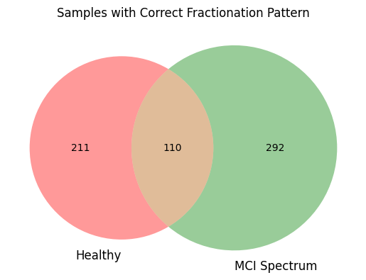

Slide 5
Alzheimer’s, Mild Cognitive Impairment, and Healthy Sample Comparisons

Slide 6
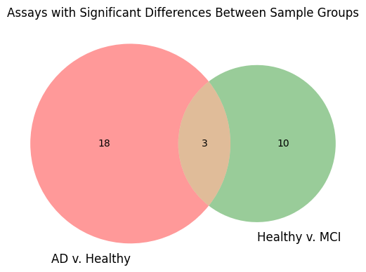
Notes:
Data analyzed using a Mann-Whitney U Test so we don’t have to assume that data is normally distributed
Did not aggregate data by fraction
Left circle is the assays where there was a significant difference (p<0.05) between AD and healthy samples; right circle is the assays where there was a significant difference (p<0.05) between MCI and healthy samples
Left two graphs are 2/3 of the assays in the overlapping part

Slide 7
Notes:
The third target from the overlapping section of venn diagram on previous slide but I think may just be a result of our samples not being age-matched

Slide 8
Long-chain-fatty-acid-CoA Ligase 1
Vasoactive intestinal polypeptide receptor 1
Functions related to fatty acid metabolism and oxidative stress
Dysfunction of ACSLs may impact cell proliferation
Associated with glioma and ALS
G-coupled protein receptor
Involved in regulation of circadian rhythms, memory, and responses to brain injury
Wu et. al., 2022; Xu et. al., 2022; Ben-Zaken et. al., 2022
Hamar et al., 2012; Henning, 2013
Notes:
Interesting paper on ASCL proteins: https://www.ncbi.nlm.nih.gov/pmc/articles/PMC9731139/

Slide 9
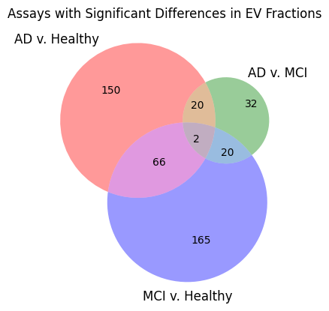
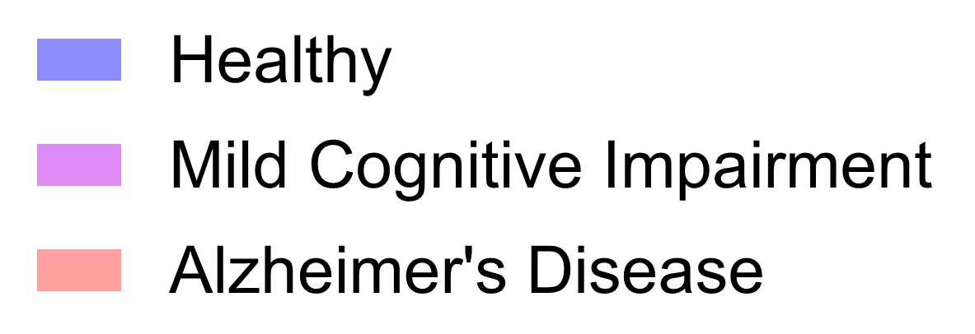
Involved in apoptosis, endo/exocytosis, membrane-cytoskeleton interactions, etc.
Lizarbe et. al., 2013; Logue et. Al. 2009
Notes:
Data analyzed using Mann-Whitney U-Test, using only fractions 9 and 10
Significant difference defined as assays where p<0.05
ANXNV and Agrin are the two targets with differences in all three groups

Slide 10
Targets with differences in all three groups
Notes:
Hidden bc I don’t know if agrin would be great to show, I think it’s mostly noise, but figured I’d include it just in case

Slide 11
Notes:
didn’t show up in the pipeline (it still needs some work) but looks like a pretty striking difference

Slide 12
Notes:
didn’t show up in the pipeline (it still needs some work) but looks like a pretty striking difference

Slide 13
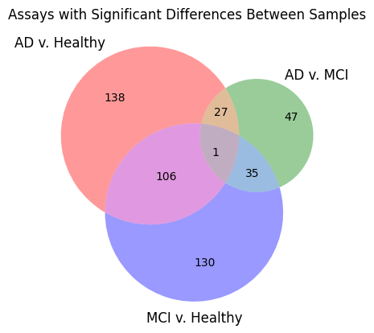
Notes:
Data analyzed via Mann-Whitney U Test, across all fractions
Hidden bc I haven’t found any usable data from it yet

Slide 14
Significant Target: Chitinase-3-like protein 1
Notes:
This is the one target that overlaps between the three circles, I think the MCI is pretty much just noise/is inconclusive so it might not be the best to show

Slide 15
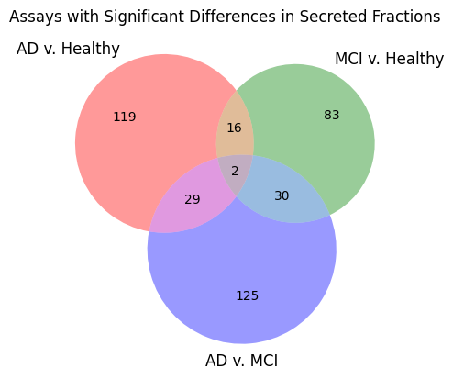
Notes:
Data analyzed using Mann-Whitney U Test, only fractions 14 and 15
Hidden bc it didn’t really give any useful data (as far as I can tell right now, will do some digging later)

Slide 16
Targets with differences in all three groups
Notes:
I don’t know how useful this data is, I don’t think it would be worth it to proceed with these targets but I figured I’d include in case you wanted to show it

Slide 17
Internal Target Discovery Pipeline

Slide 18
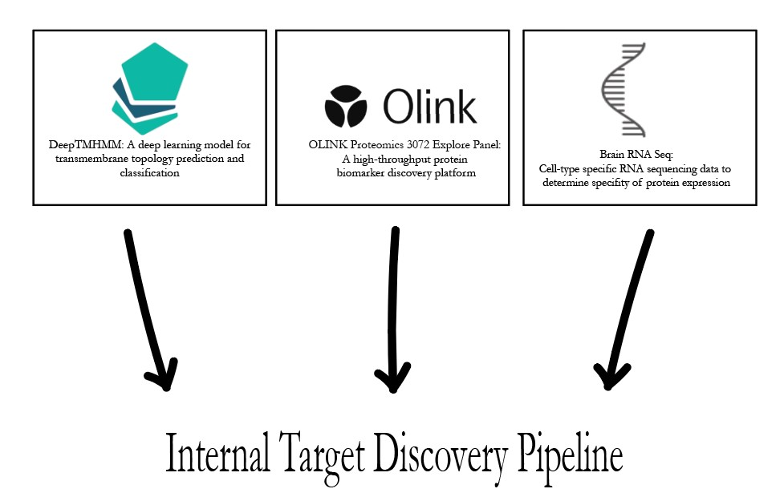
Notes:
Would be cool to put a picture of an EV with internal targets at the bottom below the “Internal Target Discovery Pipeline” line

Slide 20
New Internal Microglia Targets

Slide 21
New Internal Microglia Targets

Slide 22
New Internal Astrocyte Targets

